Slide 1


Objectives
In this session, you will learn to:
  Understand scripting
  Implement JavaScript in Web pages
  Use variables, operators, and control structures

Slide 2

Understanding Scripting
Scenario:
Facilitates Online Registration
Users are asked to specify mail or email as the mode of communication
User chooses the desired option
Based on the choice made, user is provided fields to enter details

Slide 3
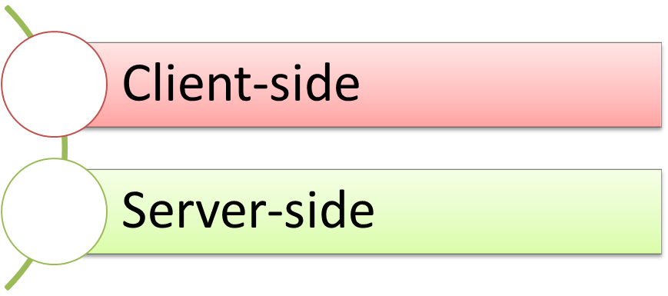
Types of Scripting
  A script:
  Is a block of code that is incorporated in Web pages to make them dynamic
  and interactive.
  Can be of two types:

Slide 4
Identifying the Benefits of JavaScript
  JavaScript provides the following benefits:
Handle events
Gather browser information
Manipulate cookies

Slide 5
Implementing JavaScript in Web Pages
JavaScript:
  Is a client-side scripting language.
  Can be directly embedded into a Web page by writing the code inside
  the <SCRIPT> tag.
  Code can also be written in an external JavaScript (.js) file.

Slide 6
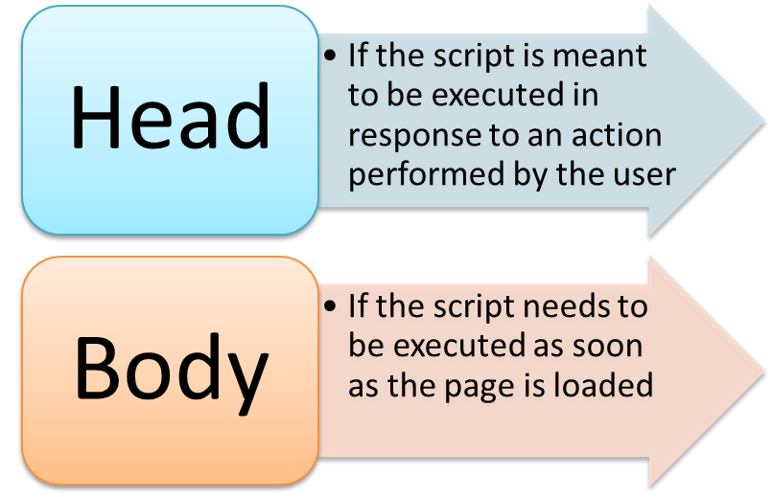
Embedding a Script into a Web Page
The JavaScript code:
  Can be inserted in the following sections of the HTML document by using the
  <SCRIPT> tag:
  Can be embedded into a Web page by using the following syntax:
    <SCRIPT type="text/javascript"> JavaScript statements
    </SCRIPT>

Slide 7
Creating and Using an External File
An external JavaScript file:
  Is saved with the .js extension.
  Can be referred inside an HTML document using the src attribute of the
  <SCRIPT> tag.

Slide 8
Just a Minute
Which one of the following attributes is used to specify the path of an external
JavaScript file?
  src
  type
  url
  text

Slide 9
Just a Minute (Contd.)
Solution:
  src

Slide 10
Identifying Rules and Conventions Used in JavaScript
JavaScript rules and conventions:
Semicolons
Quotes
Case sensitivity
Comments

Slide 11
Demo: Implementing JavaScript in Web Pages
Problem Statement:
  Steve has been asked to implement functionality in the Upcoming Movies Web page in such a way that when the user opens this page, an alert message appears that specifies the bookings are currently not available. In addition, the same alert should appear when the user clicks any of the BookYourShow links.
  Prerequisite: You need to use the solution of ShowOnWheels that you have created in Activity 3.2 to perform this activity. Ask your faculty to provide you the same.

Slide 12
Demo: Implementing JavaScript in Web Pages (Contd.)
Solution:
  To display an alert on a Web page, Steve needs to perform the following tasks:
  1. Update the upcomingmovies.html file.
  2. View the home page.

Slide 13
Using Variables, Operators, and Control Structures
In JavaScript, to compare values and evaluate expressions, you need:
Variables
Operators
Conditional Constructs
Looping Constructs

Slide 14
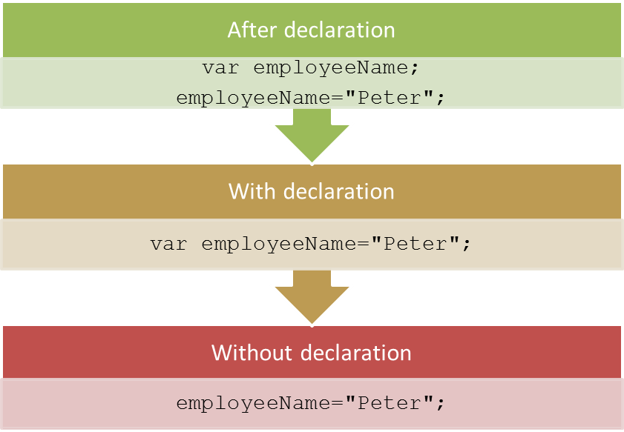
Defining Variables
A variable:
  Is a named location in memory that is used to store a value.
  Is declared by using the following syntax:
    var var_name;
  Can be assigned a value in the following ways:

Slide 15
Using Operators
An operator:
  Is a set of one or more characters that is used for computations or comparisons.
  Can be used to modify the values stored in the variables.
  Can belong to any one of the following categories:
Arithmetic
Assignment
Arithmetic Assignment
Comparison
Logical

Slide 16
Using Operators (Contd.)
An arithmetic operator:
  Is used to perform arithmetic operations on variables and literals.
  Can be of the following types:
    +
    -
    *
    /
    %
    An assignment operator:
  Is used to assign a value or a result of an expression to a variable.

Slide 17
Using Operators (Contd.)
Arithmetic assignment operators:
  Are used to perform arithmetic operations and assign the value to the variable at the
  left side of the operator.
  Are of the following types:
    +=
    -=
    *=
    /=
    %=

Slide 18
Using Operators (Contd.)
    Comparison operators:
  Are used to compare two values and perform an action on the basis of the comparison.
  Are of the following types:
    <
    >
    <=
    >=
    ==
    !=
    ===

Slide 19
Using Operators (Contd.)
Logical operators:
  Are used to evaluate complex expressions.
  Return a boolean value.
  Are of the following types:
    &&
    !
    ||

Slide 20
Summary
In this session, you learned that:
  To create a dynamic and interactive Web page, you need to incorporate a block of code, which is known as script, in the Web page.
  Scripting can be of two types:
    Client-side scripting
    Server-side scripting
  A script can be embedded directly into a Web page by writing the JavaScript code inside the <SCRIPT> tag or by writing the entire JavaScript code in an external JavaScript (.js) file.
  A variable is a named location in memory that is used to store a value.
  Values can be assigned to a variable in the following ways:
    Assigning a value to a variable after its declaration
    Initializing a variable while declaring it
    Initializing a variable without declaring it explicitly
  An operator is a set of one or more characters that is used for computations or comparisons.
  You can use the following categories of operators in JavaScript:
    Arithmetic operators
    Assignment operators
    Arithmetic assignment operators
    Comparison operators
    Logical operators

